Slide 1

Customer Churn Prediction
Predicting customer return behavior using machine learning on Online Retail dataset with 541,909 transactions.

Slide 2
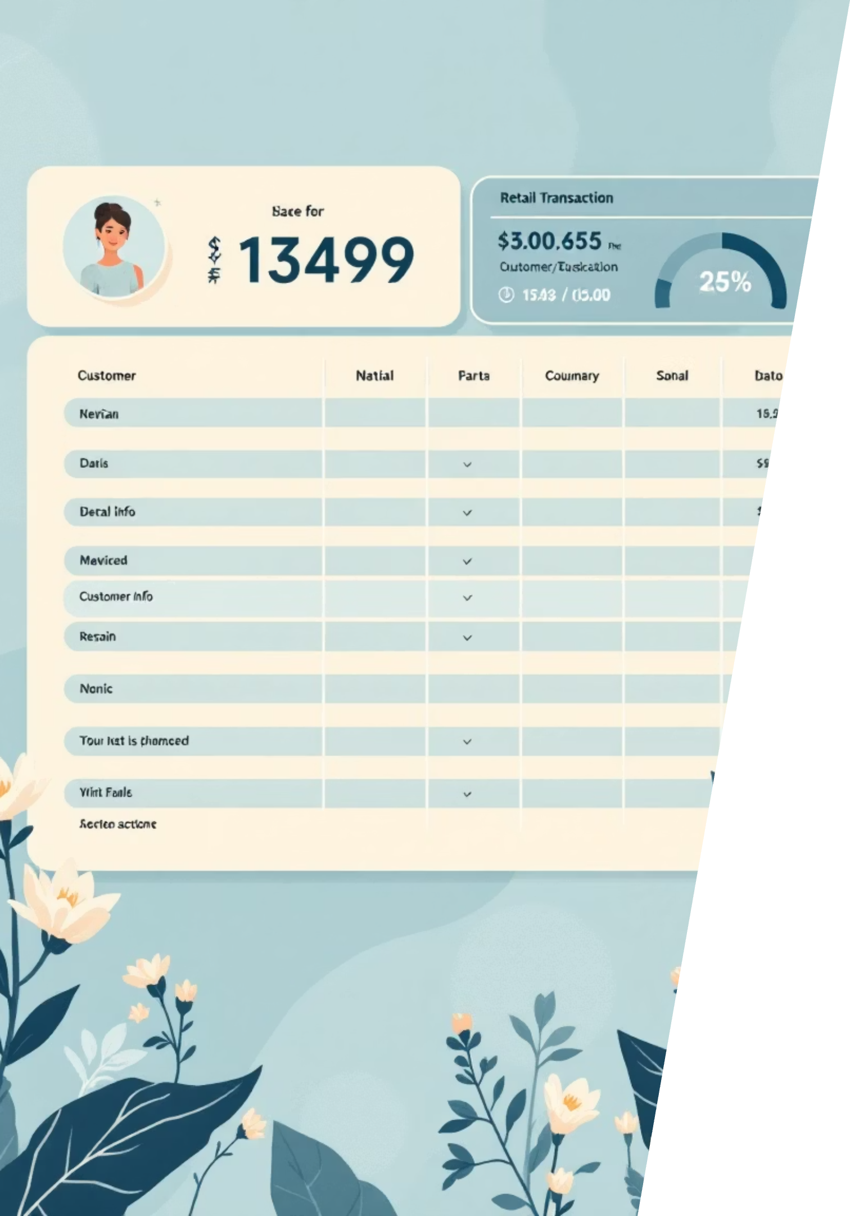
Project Overview
Dataset
Target Variable
541,909 rows, 8 features from Online Retail.csv
will_return: Binary classification (purchased again in 3 months)
Key Objective
Build predictive models with proper imbalance handling and feature engineering

Slide 3


Exploratory Data Analysis
Distribution Analysis
Histograms and boxplots revealed Quantity, UnitPrice, and CustomerID patterns with long-tail product distribution.
Correlation Insights
Correlation matrix identified relationships among numeric features.
Data Quality
Detected negative quantities indicating returns and cancellations requiring special handling.

Slide 4


Class Imbalance Diagnosis
57.4%
42.6%
Will Return
Will Not Return
Customers who purchased again
Customers who did not return
Ratio of 1:1.3 indicates weak imbalance. Applied class_weight='balanced' and oversampling methods to address.

Slide 5

Feature Engineering: RFM Analysis
Recency
Frequency
Monetary
Days since last purchase
Number of invoices per customer
Total customer spending
RFM features combined with existing attributes to enhance predictive power and capture customer behavior patterns.

Slide 6
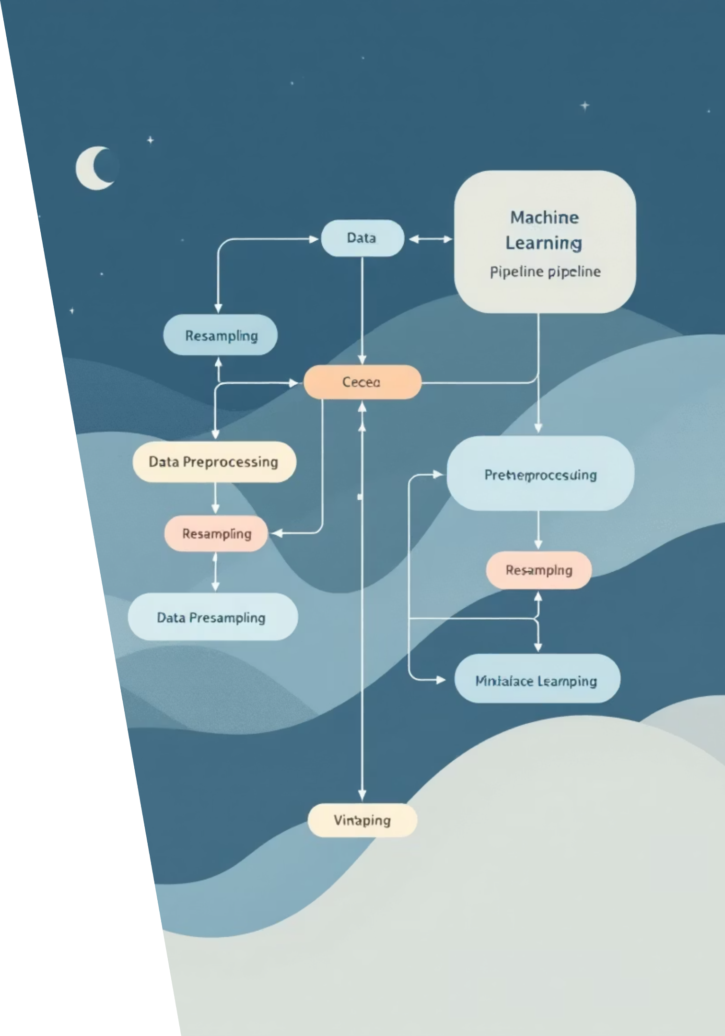
Imbalance Handling Techniques
Class Weighting
Applied balanced weights in RandomForest to penalize minority class misclassification.
ADASYN Oversampling
Adaptively balanced minority class with focus on harder-to-learn samples.
SMOTE Tuning
GridSearchCV optimized k_neighbors parameter (best value: 10) for synthetic sample generation.
ML Pipeline
Automated scaling, SMOTE, and Logistic Regression in unified pipeline.

Slide 7
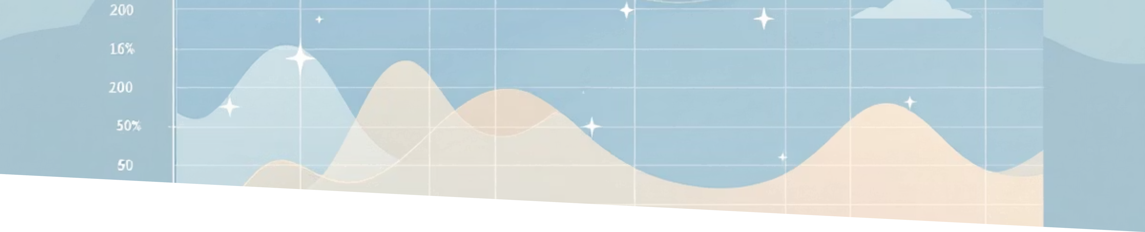
Models & Evaluation Metrics
Models Tested
Evaluation Metrics
Logistic Regression
Precision, Recall, F1-score
Gradient Boosting
ROC-AUC, PR-AUC
Support Vector Machine
StratifiedKFold (5 folds)
Random Forest
Confusion Matrix

Slide 8

Best Model Performance
0.7549
0.7392
0.6592
ROC-AUC Score
Mean CV ROC-AUC
Mean F1-Score
Logistic Regression test performance
Cross-validation with ±0.0207 std dev
Cross-validation with ±0.0248 std dev
Logistic Regression with SMOTE and cross-validation inside folds achieved strongest performance.

Slide 9



Feature Importance Analysis
100%
33%
Frequency
Avg Price
Coef: +1.71 (strongest predictor)
Coef: -0.57 (negative correlation)
29%
27%
Total Spent
Unique Products
Coef: +0.50 (positive impact)
Coef: +0.47 (engagement indicator)
Purchase frequency is the strongest predictor of customer return behavior, followed by spending patterns.

Slide 10

Key Findings & Future Directions
Core Insight
Churn strongly influenced by purchase frequency and monetary value.
Advanced Techniques
Successfully implemented ADASYN, SMOTE tuning, and cross-validation with oversampling inside folds.
Next Steps
Implement cost-sensitive evaluation and explore ensemble methods with hyperparameter tuning for improved performance.

